Slide 1



HPI Real Estate Fund X
FOR ACCREDITED INVESTOR USE ONLY – NOT FOR INVESTING PUBLIC
Securities offered through Orchard Securities, LLC, member FINRA/SIPC. Orchard Securities, LLC and Hamilton Point Investments LLC are not affiliated companies.

Slide 2

The information contained herein is for informational purposes only and is not an offer or solicitation to purchase any securities. This material is for accredited investors only (generally described as a net worth of greater than one million dollars, exclusive of primary residence). Complete information related to the offering, including risks, is contained within the confidential private placement memorandum dated June 1, 2022 and its respective supplements (collectively, the"PPM"), supersedes the information contained herein in its entirety.
An investment in HPI Fund X is a private placement securities offering. Private Placements are illiquid speculative investments and carry a high degree of risk, including the loss of the entire investment. Potential cash flows, returns, and appreciation are not guaranteed. Investors must review the PPM in its entirety before making an investment decision.
FOR ACCREDITED INVESTOR USE ONLY – NOT FOR INVESTING PUBLIC

Slide 3
Risk Factors
An investment in HPI is subject to various risks, which are set forth more specifically in the PPM, and include but are not limited to, the following:
Real Estate Risks
Fluctuations in occupancy rates, rent schedules, operating expenses, interest rates, real estate tax rates;
Changes in governmental rules, regulations and fiscal policies;
The effects of inflation and enactment of unfavorable real estate, rent control, environmental, zoning or hazardous material laws;
Uninsured losses;
Covid-19 and the government’s response, economic impact of shut downs, unemployment, inability of tenants to pay rent, eviction moratoriums;
Risks related to the renovation and rehabilitation of properties, including construction risks;
The general economic climate and changes in the overall real estate market and local real estate conditions; and
The financial condition of tenants, buyers and sellers of properties, and supply of or demand for competing properties.

Slide 4
Financing Risks
Financing may exceed the anticipated loan-to-value ratio of 65% to 70% for all of the properties acquired;
No existing commitment for any loans has been obtained and, therefore, the amount and terms of any future loans are uncertain and will be negotiated by the Manager;
No assurance can be given that future cash flow will be sufficient to make the debt service payments on loans encumbering acquired properties and to cover all operating expenses of the properties;
If property revenues are insufficient to pay debt service and operating costs, and additional working capital is unavailable, lenders may foreclose on one or more properties and investors could lose their investment
Risks Relating to the Formation and Internal Operation of the Company
HPI Fund X is a newly formed business entity with no history of operations and limited assets, is subject to the risks involved with any speculative new venture and no assurance can be given that it will be profitable;
There can be no assurance that cash distributions will in fact be made or, if made, whether those distributions will be made when or in the amount anticipated;
Delays in making cash distributions could result from the inability of HPI to purchase, develop or operate its assets profitably;
All decisions regarding the management of HPI’s affairs will be made exclusively by the Manager and not by the investors and, therefore, investors should not purchase an interest in HPI unless they are willing to entrust all aspects of management to the Manager; and
The Manager and its affiliates are engaged in other activities and intend to continue to engage in such activities in the future, and will have conflicts of interest in allocating management time, services and functions between various existing enterprises and future enterprises which they may organize or in which they may become involved.

Slide 5
Risks Relating to Private Offering and Lack of Liquidity
An interest in HPI is not freely transferable and an investor must bear the economic risk of his, her or its investment for an indefinite period of time;
There will be no market for interests in HPI and an investor cannot expect to be able to liquidate his, her or its investment in the case of an emergency;
Any transfer of an interest in HPI requires the prior written consent of the Manager; and
HPI may raise significantly less than the target equity raise which would limit the number of properties it may acquire, thereby potentially affecting investors’ return on investment.
Tax Risks
An investment in HPI entails substantial federal income tax risks, some of which are described in the PPM.
The foregoing is merely an overview of the risks inherent in an investment in HPI. Prospective investors are advised to consult with their tax, financial and business advisors prior to investing.
This material is designed for marketing purposes only and does not constitute an offer to sell or a solicitation of an offer to buy securities. The securities offered pursuant to the PPM have not been registered under the Securities Act of 1933, as amended, or any applicable state securities laws. Neither the U.S. Securities and Exchange Commission nor any state regulatory authority has passed upon the adequacy or accuracy of the information contained herein or endorsed the merits of this offering. Information contained herein is subject to change and is qualified in its entirety by the PPM. Investment in HPI is limited to Accredited Investors (as such term is defined in Rule 501(a) of Regulation D).

Slide 6
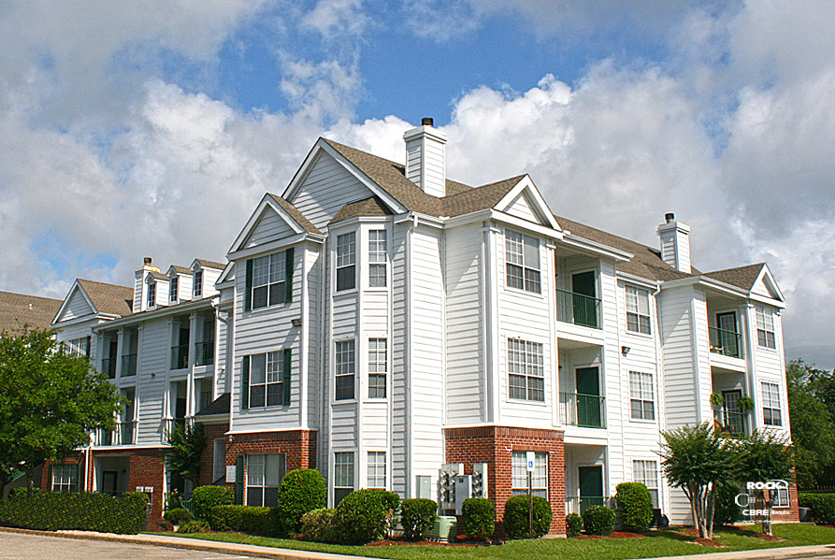

Hamilton Point Investments (“HPI”) - Overview
Real estate investment firm founded in 2009 by David Kelsey and Matthew Sharp
Sponsor of real estate private-equity investment funds
Experienced multifamily apartment managers in secondary growth markets
Have acquired over 23,000 apartment units for nearly $2 billion
Over 200 employees and is headquartered in Old Lyme, CT
* Pictured properties are either owned or have been owned by an affiliate of the Manager. HPI Fund X does not own or receive income from the pictured property, but property is representative of those the Fund intends to acquire.

Slide 7
Typical Investment Criteria
Property
Age: Post 2000
Location
Secondary or tertiary markets
Growing population
Tenants
Below replacement cost pricing
Potential to add value
Class A-/B+
Growing employment
Proximity to universities, hospitals and major employers
Easy highway access
Working professionals
Families
Diverse residents

Slide 8
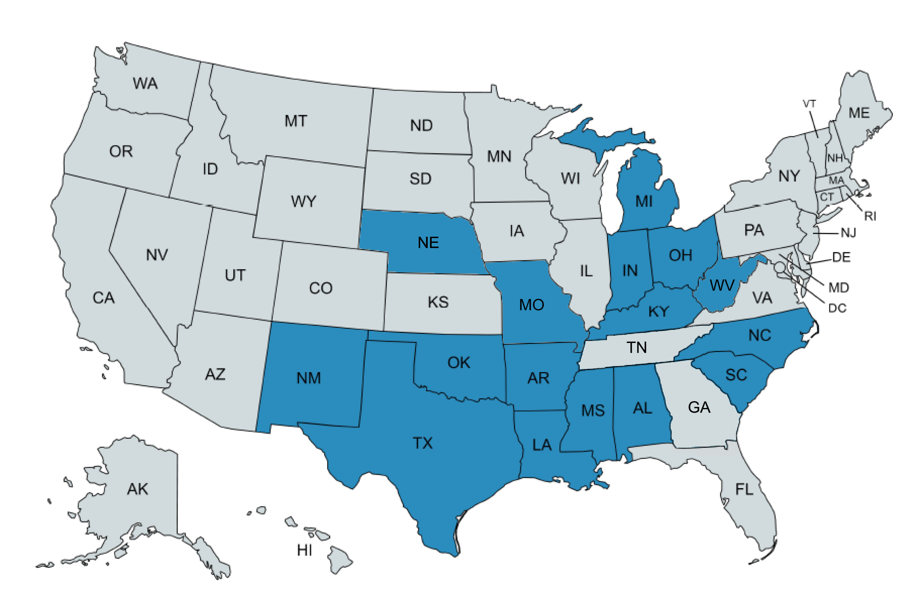

Current Markets
States:
Alabama
Arkansas
Indiana
Kentucky
Louisiana
Michigan
Mississippi
Missouri
Nebraska
New Mexico
North Carolina
Ohio
Oklahoma
South Carolina Texas
West Virginia

Slide 9
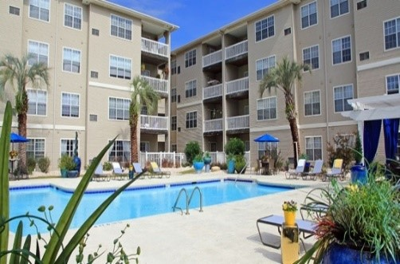
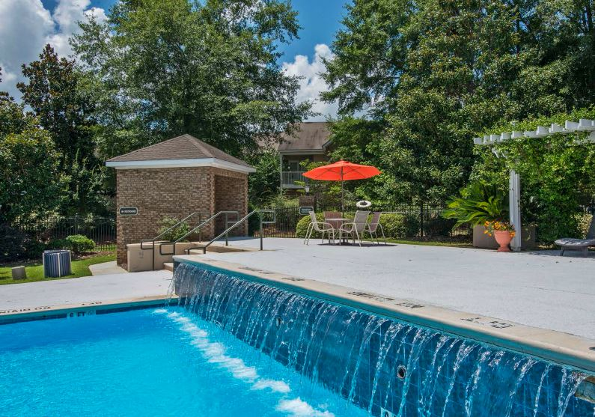
Investment Strategy Add Value, Increase Rents, Reduce Expenses*
Acquire below replacement cost in growth corridors
Acquire class A-/B+ properties built early to mid-2000s
Similar community features to newly built properties
Unit interiors similar to newly built properties
Post 2000 construction typically has:
Greater square footage
Walk-in closets
Laundry room in the unit
9-foot ceilings and decorative moldings
More bathrooms
Community amenities
Less deferred maintenance
* There are no guarantees that the Fund will be able to successfully execute its strategy
**The asset pictured is not owned by the Fund and is not anticipated to be owned by the Fund, but is representative of the type of asset the Fund intends to acquire
Notes:
-Upgrade unit interiors to new construction standards
-Often results in increased rents and property values

Slide 10
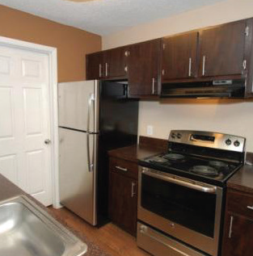
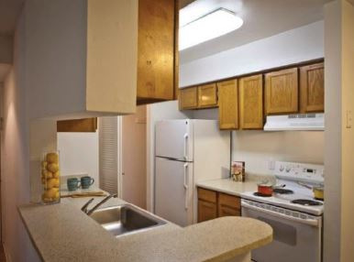
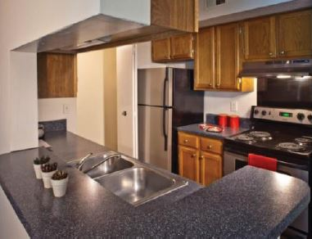

Add Value with Unit Upgrades
Kitchens
Countertop upgrades to a granite look using a spray on product
Paint or resurface cabinets
Brushed nickel hardware
New faucets and drawer pulls
Contemporary lighting
Upgraded
Original
→
* The photos above depict improvements made to real estate acquired by prior programs sponsored by Hamilton Point Investments, LLC and not properties owned by HPI Fund X LLC.

Slide 11
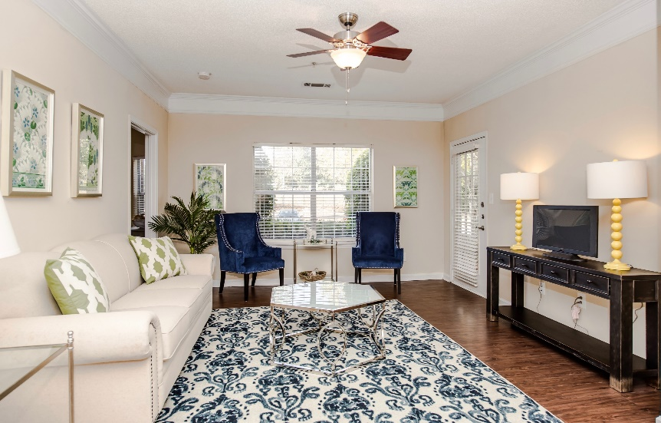

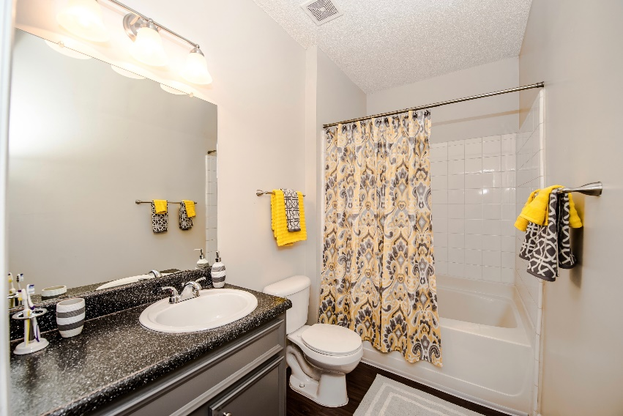
Add Value with Unit Upgrades
Living Areas
Vinyl plank flooring that looks like wood
Sturdy six-panel doors
Upgraded
Bathrooms
Vinyl plank or tile flooring
Countertop upgrade to granite look
Brushed nickel hardware
Resurfaced cabinets
Contemporary lighting
Original
→
* The photos above depict improvements made to real estate acquired by prior programs sponsored by Hamilton Point Investments, LLC and not properties owned by HPI Fund X LLC.

Slide 12
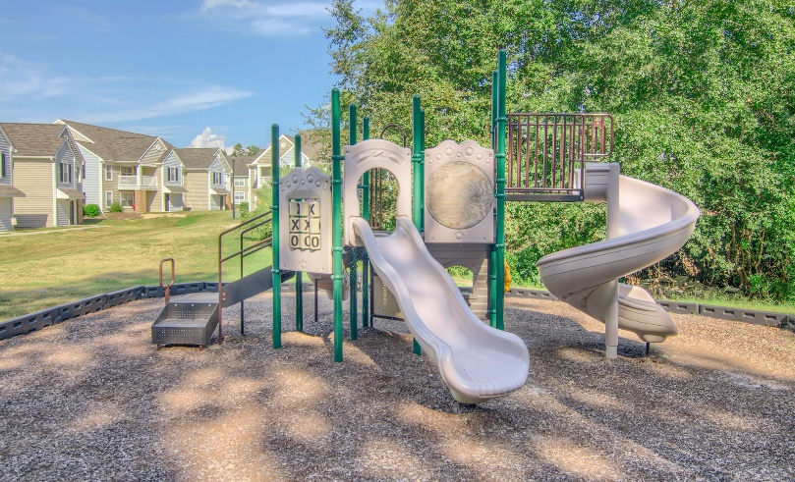
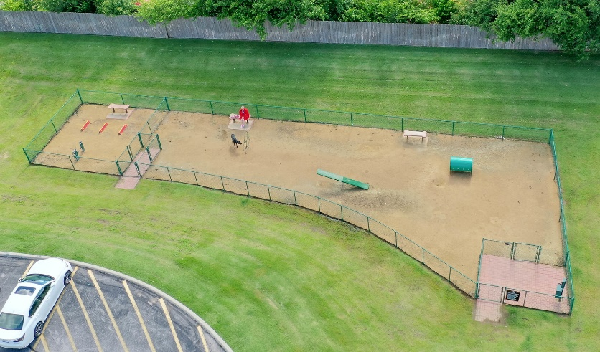
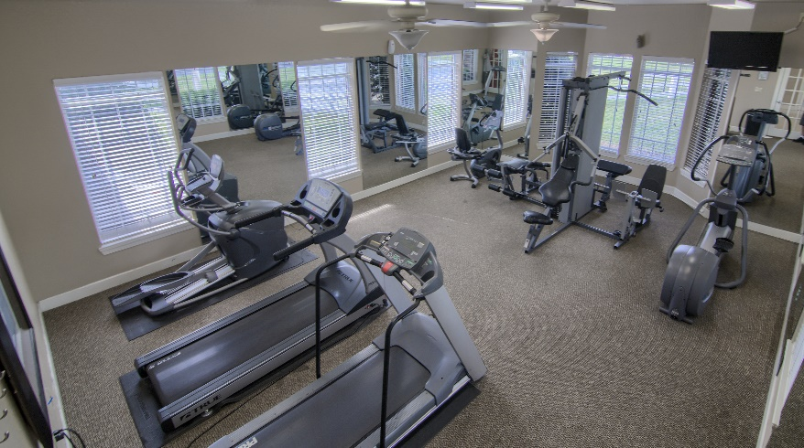
Add value with Amenity Upgrades
Playground
Dog Park
Gym
* The photos above depict improvements made to real estate acquired by prior programs sponsored by Hamilton Point Investments, LLC and not properties owned by HPI Fund X LLC.

Slide 13

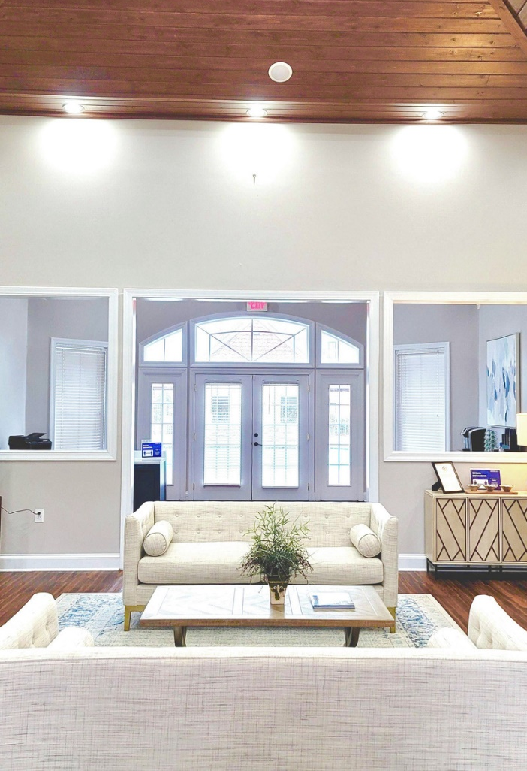
Add value with Community Common Area Upgrades
Original Clubhouse/Leasing office
Upgraded Clubhouse/Leasing office
→
* The photos above depict improvements made to real estate acquired by prior programs sponsored by Hamilton Point Investments, LLC and not properties owned by HPI Fund X LLC.

Slide 14
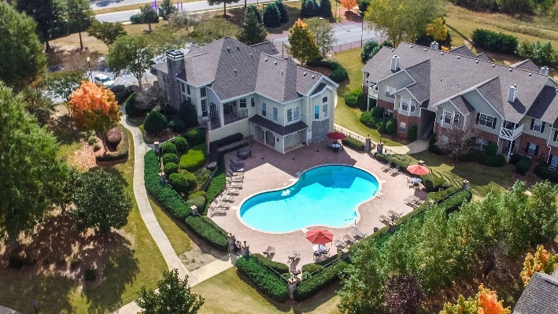
Investment Strategy*
To increase the value of the portfolio by increasing the portfolio’s income. HPI intends to make modest unit and common area upgrades that HPI believes should result in increased rental income. Buyers pay a multiple on the net operating income (NOI) of the real estate in the form of a cap rate.
Hypothetical example:
Assume unit upgrades for $1,500 per unit
Assume average rent increase of $40 per month x 12 months
= $480 per year of additional
Net Operation Income or NOI per unit
* We can provide no assurances that the Fund will successfully execute this strategy. The example above is based upon HPI’s experience in previous funds. The amount of money spent per unit will differ and depends on the condition of the individual property and economic conditions present in the specific market. The numbers are for illustrative purposes only and are not a guarantee of performance or outcome at a specific property or fund. Actual returns may vary and or may not materialize at all.
** The asset pictured is not owned by the Fund and is not anticipated to be owned by the Fund, but is representative of the type of asset the Fund intends to acquire.
Notes:
$480 per year of additional
$480 / 6.9% cap rate
= $7,000 value added, per unit

Slide 15
HPI Historical Performance**
All Full-Cycle Programs:
To date HPI has offered 10 private real estate funds and 7 DST programs. Funds I, II, III, IV, V and VI have gone full cycle, as have seven DST programs. The remaining funds continue to be operated by HPI and are within their projected hold period.
Fund I: Full-cycle 14.50% average IRR; 4-year hold period*, **
Fund II: Full-cycle 14.64% average IRR; 4-year hold period*, **
Fund III: Full-cycle 18.23% average IRR; 3.5-year hold period*, **
Fund IV: Full-cycle 14.3% average IRR; 5-year hold period*,**
Fund V: Full-cycle 16.8% average IRR; 4.5-year hold period*,**
Fund VI: Full-cycle 21.1% average IRR; 4 year hold period*,**
HPI Garden Park DST: 20% average IRR; 3-year hold period*, **
HPI Wilcox DST: 14% average IRR; 4-year hold period*, **
HPI Crocker House DST: 14.4% IRR; 3.5-year hold period*, **
HPI Mill Creek Run DST: 14.1% IRR; 4-year hold period*, **
HPI Waterford Landing DST: 16% IRR; 3-year hold period*, **
HPI Villas by the Lake DST: 13.4% IRR; 3-year hold period*, **
HPI Plantation Apartments DST: 8.0% IRR; 5 year hold period*,** Track Record:
Purchased 97 multi-family properties totaling over 23,000 units
Sold over 69 properties in full cycle events, all profitable
Do what we say – stick to strategy and business plan
Have always met or exceeded targeted distributions
*Please note that the internal rate of return in an investment vehicle may differ greatly on an individual investor basis depending on the timing of
an Investor’s entrance and exit from the vehicle and whether the investor invested net of any up-front commissions and fees.
**Past performance is not indicative of future results, and there is no way to predict what the future IRR will be for Fund X.

Slide 16

Fund X Summary
Fund Name | HPI Real Estate Fund X LLC
Asset Class | Class A-/B+ Multifamily
Targeted Equity Raise | $150,000,000
Anticipated leverage | 65% to 70%
Preferred Returns* | 6.00% annual distribution, paid quarterly
Targeted Life of Fund** | 4-6 years
Sponsor Co-Invest*** | $2,000,000 of units - purchased net of commissions
Acquisition Fee | 1% of purchase price
Asset Management Fee | 2% of equity raised, subordinate to 6.00% annual distribution
Incentive Fee | 75/25 over 6.00% hurdle
Financing Fee | NONE
Project Oversight Fee | NONE
Disposition Fee | NONE
*The preferred return is not guaranteed and is contractual in nature and is paid in accordance with Fund X’s Operating Agreement.
**We can provide no assurances these targets will be met.
***J. David Kelsey and Matthew A. Sharp, the managers of the Manager (the “HPI Managers”), each will purchase 150 Units with a gross value of $750,000, such that HPI Fund X will be capitalized with $1,365,000 (the net cash proceeds). Messrs. Kelsey and Sharp will invest on the same terms as purchasers in this offering, provided that their investment will be net of certain fees typically payable to broker-dealers, but not net of Organizational and Offering expenses. In addition, Messrs. Kelsey and Sharp have agreed to purchase an additional 50 Units each with a gross value of $250,000, such that HPI Fund X will be capitalized with an additional $455,000 (the net cash proceeds). The purchase of such additional Units may be made at such time as Messrs. Kelsey and Sharp determine in their sole discretion.

Slide 17


Summary
Newer multifamily with reasonable risk/return profile
Basis below replacement cost in growth markets
Upside from moderate unit upgrades
Competitive fee structure and strong alignment of interests
Demonstrable track record
Potential tax advantaged current cash flow

Slide 18


2 Huntley Road
Old Lyme, CT 06371
(860) 598-4300
J. David Kelsey
Managing Principal
kelsey@hamiltonptinv.com
Matthew A. Sharp
Managing Principal
sharp@hamiltonptinv.com
For offering materials, please contact:
Elizabeth Wallett
Director of Investor Relations (860) 598-5008
wallett@hamiltonptinv.com
FOR ACCREDITED INVESTOR USE ONLY – NOT FOR INVESTING PUBLIC
Securities offered through Orchard Securities, LLC, member FINRA/SIPC. Orchard Securities, LLC and Hamilton Point Investments LLC are not affiliated companies.

